Slide 1
JQuery

Slide 2
What is jQuery
jQuery is a small, light-weight and fast JavaScript library. It is cross-platform and supports different types of browsers. It is also referred as ?write less do more? because it takes a lot of common tasks that requires many lines of JavaScript code to accomplish, and binds them into methods that can be called with a single line of code whenever needed. It is also very useful to simplify a lot of the complicated things from JavaScript, like AJAX calls and DOM manipulation.
jQuery is a small, fast and lightweight JavaScript library.
jQuery is platform-independent.
jQuery means "write less do more".
jQuery simplifies AJAX call and DOM manipulation.

Slide 3
Ajax (Asynchronous JavaScript and XML)
Ajax (Asynchronous JavaScript and XML) is a method of building interactive applications for the Web that process user requests immediately. Ajax combines several programming tools including JavaScript, dynamic HTML, Extensible Markup Language ,cascading style sheets , the Document Object Model . Ajax allows content on Web pages to update immediately when a user performs an action, unlike an http request, during which users must wait for a whole new page to load.
Google Maps is one well-known application that uses Ajax.

Slide 4
jQuery Features
Following are the important features of jQuery.
HTML manipulation
DOM manipulation
DOM element selection
CSS manipulation
Effects and Animations
AJAX
HTML event methods

Slide 5
Why jQuery is required
Sometimes, a question can arise that what is the need of jQuery or what difference it makes on bringing jQuery instead of AJAX/ JavaScript? If jQuery is the replacement of AJAX and JavaScript? For all these questions, you can state the following answers.
It is very fast and extensible.
It facilitates the users to write UI related function codes in minimum possible lines.
It improves the performance of an application.
Browser's compatible web applications can be developed.
It uses mostly new features of new browsers.
So, you can say that out of the lot of JavaScript frameworks, jQuery is the most popular and the most extendable. Many of the biggest companies on the web use jQuery.
Some of these companies are:
Microsoft
Google
IBM
Netflix

Slide 6
Running jQuery
jQuery exists as a single external JS file. You can run jQuery one of two ways:
Download the jQuery library file to your computer
Link to a remotely hosted version of the library code from a reliable website
Each option has its pros and cons
Download: The main benefit is that if you are offline, the file will still be there on your computer when you are developing your code.
Link: These externally linked files are typically the most up to date. However, it requires that the viewer of your page is online. It also takes a few extra milliseconds which can, in theory, slow down your site a little bit. Still, once your page goes ‘live’, we typically use the version linking to an external file.

Slide 7
Using the externally linked version. (RECOMMENDED)
There are many different servers from reputable companys such as Microsoft, Google, jQuery and others.
Here is the link to the April 2017 version on Google’s site.
<script src="https://ajax.googleapis.com/ajax/libs/jquery/3.2.0/jquery.min.js"></script>
Remember that this link must go in the ‘head’ section of your HTML file.
Note that the closing </script> tag IS required.
This link must be present on every page in which you use jQuery commands.
Not surprisingly, this link must appear before any jQuery commands you use.

Slide 8
Basic syntax
Basic syntax is: $(selector).action()
A $ sign to define/access jQuery
A (selector) to "query (or find)" HTML elements
A jQuery action() to be performed on the element(s)
Examples:
$("p").hide() - hides all <p> elements.
$(".test").hide() - hides all elements with class="test".
$("#test").hide() - hides the element with id="test".

Slide 9
<script>
$(document).ready(
function()
{
// Some jQuery code will
// go in here...
}
);
</script>

Slide 10
$(document).ready() and $()
The code inserted between $(document).ready() is executed only once when page is ready for JavaScript code to execute.
In place of $(document).ready(), you can use shorthand notation $() only.

Slide 11
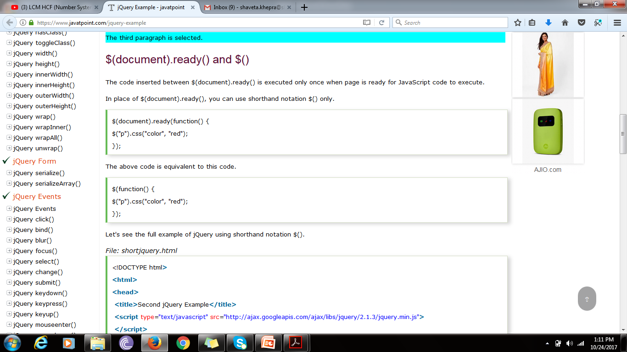

Slide 12
jQuery Example
<!DOCTYPE html>
<html>
<head>
<script src="https://ajax.googleapis.com/ajax/libs/jquery/3.2.1/jquery.min.js"></script>
<script>
$(document).ready(function(){
$("button").click(function(){
$("p").hide();
}); });
</script>
</head>
<body><h2>This is a heading</h2>
<p>This is a paragraph.</p><p>This is another paragraph.</p>
<button>Click me</button></body></html>

Slide 13
<!DOCTYPE html>
<html>
<head>
<script src="https://ajax.googleapis.com/ajax/libs/jquery/3.2.1/jquery.min.js"></script>
<script>
$(document).ready(function(){
$("p").css("color", "red");
});
</script>
</head>
<body>
<p>The first paragraph is selected.</p>
<p>The second paragraph is selected.</p>
<p>The third paragraph is selected.</p>
</body>
</html>

Slide 14
jQuery Selectors
jQuery Selectors are used to select and manipulate HTML elements. They are very important part of jQuery library.
With jQuery selectors, you can find or select HTML elements based on their id, classes, attributes, types and much more from a DOM.
All jQuery selectors start with a dollor sign and parenthesis e.g. $(). It is known as the factory function.

Slide 15
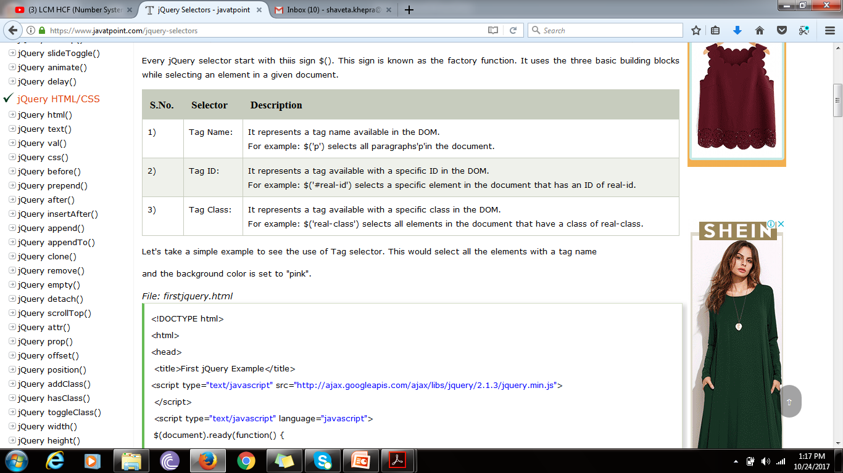
The $() factory function
Every jQuery selector start with this sign $(). This sign is known as the factory function. It uses the three basic building blocks while selecting an element in a given document.

Slide 16
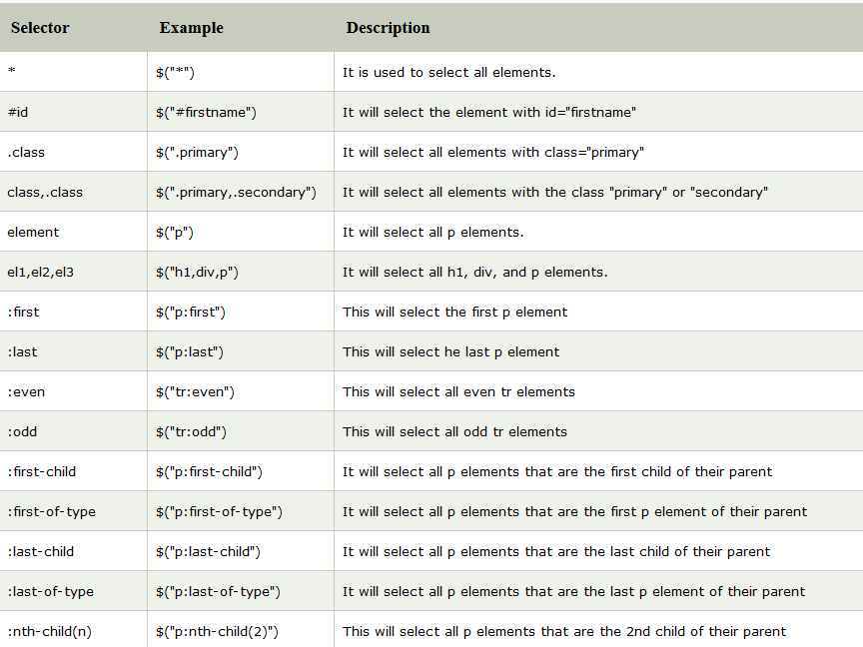

Slide 17
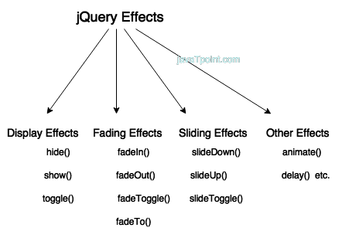
jQuery Effects
jQuery enables us to add effects on a web page. jQuery effects can be categorized into fading, sliding, hiding/showing and animation effects.

Slide 18
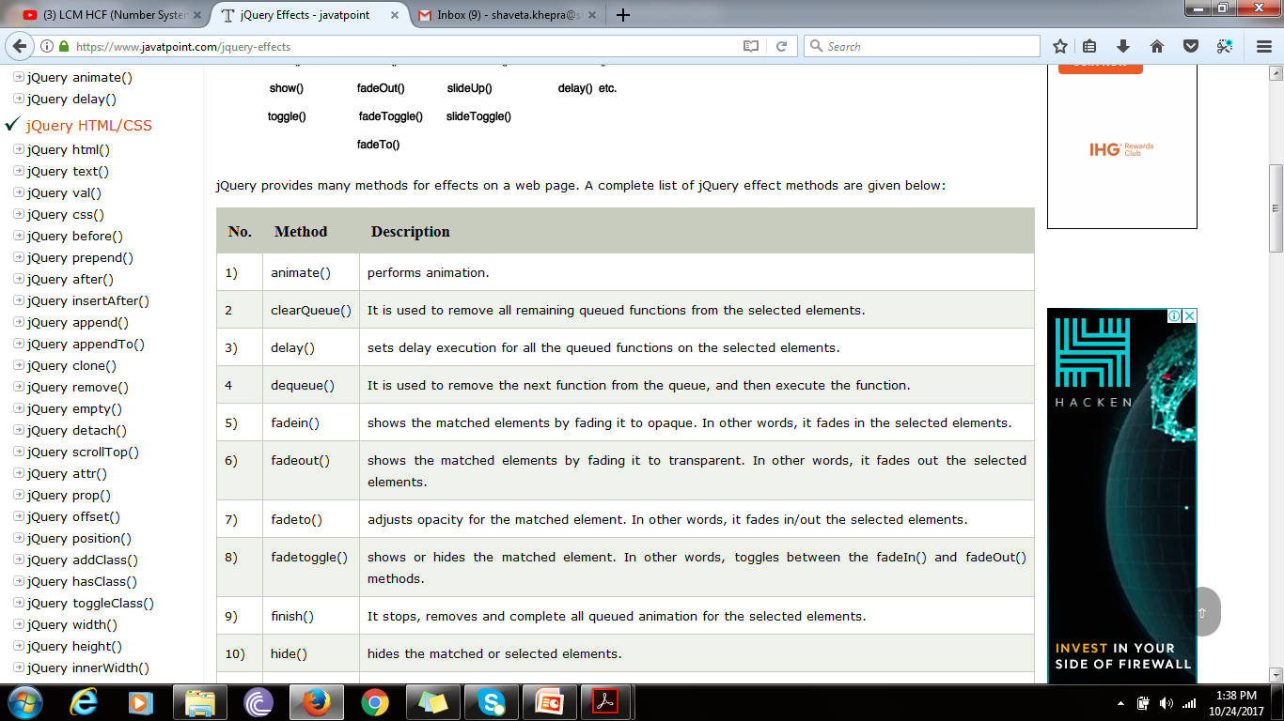

Slide 19
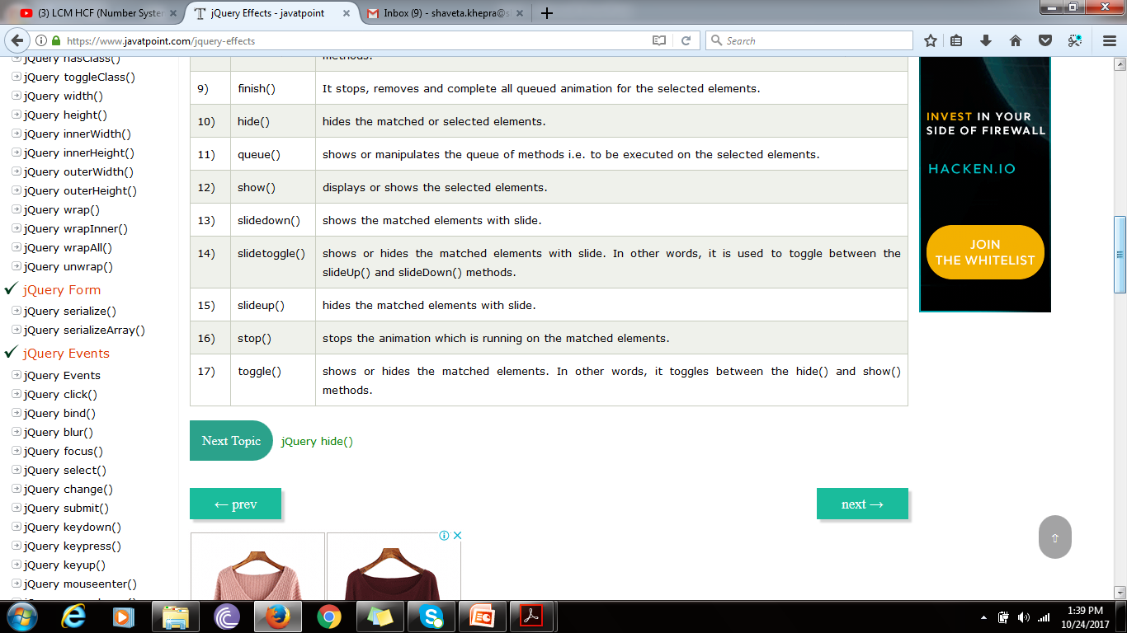

Slide 20
jQuery hide() and show()
<!DOCTYPE html>
<html><head>
<script src="https://ajax.googleapis.com/ajax/libs/jquery/3.2.1/jquery.min.js"></script>
<script>$(document).ready(function(){
$("#hide").click(function(){
$("p").hide();
});
$("#show").click(function(){
$("p").show();
});
});
</script></head><body><p>If you click on the "Hide" button, I will disappear.</p>
<button id="hide">Hide</button>
<button id="show">Show</button>
</body></html>

Slide 21
jQuery toggle()
<!DOCTYPE html>
<html><head><script src="https://ajax.googleapis.com/ajax/libs/jquery/3.2.1/jquery.min.js"></script>
<script>
$(document).ready(function(){
$("button").click(function(){
$("p").toggle();
});
});
</script></head><body>
<button>Toggle between hiding and showing the paragraphs</button>
<p>This is a paragraph with little content.</p>
<p>This is another small paragraph.</p></body></html>

Slide 22
jQuery Fading Methods
With jQuery you can fade an element in and out of visibility.
jQuery has the following fade methods:
fadeIn()
fadeOut()
fadeToggle()
fadeTo()

Slide 23
jQuery fadeIn()
<!DOCTYPE html>
<html><head><script src="https://ajax.googleapis.com/ajax/libs/jquery/3.2.1/jquery.min.js"></script>
<script>
$(document).ready(function(){
$("button").click(function(){
$("#div1").fadeIn();
$("#div2").fadeIn("slow");
$("#div3").fadeIn(3000);
});
}); </script></head><body><p>Demonstrate fadeIn() with different parameters.</p>
<button>Click to fade in boxes</button><br><br>
<div id="div1" style="width:80px;height:80px;display:none;background-color:red;"></div><br>
<div id="div2" style="width:80px;height:80px;display:none;background-color:green;"></div><br>
<div id="div3" style="width:80px;height:80px;display:none;background-color:blue;"></div>
</body></html>

Slide 24
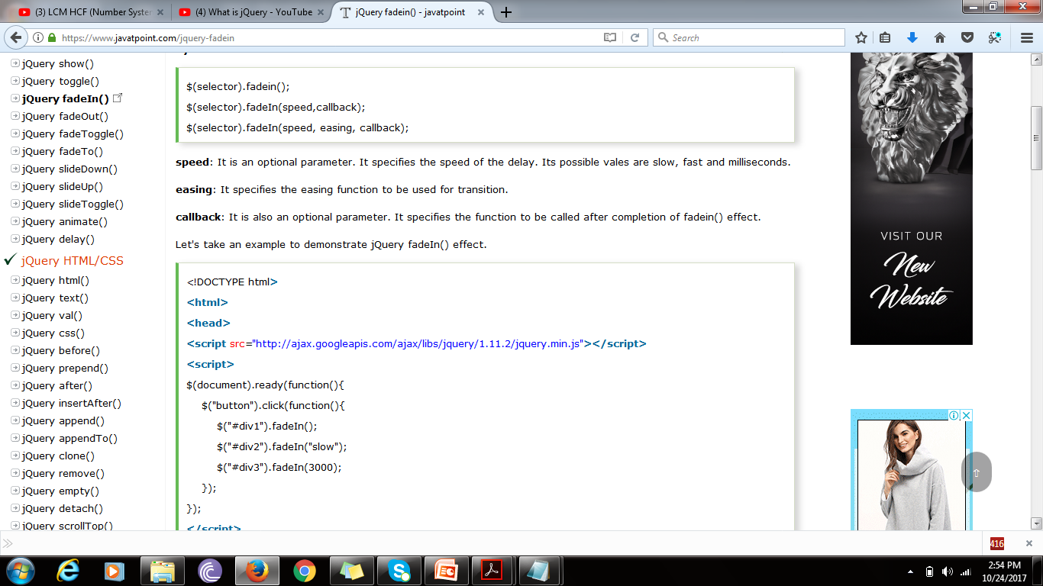
jQuery fadeIn()

Slide 25
<!DOCTYPE html>
<html> <head>
<script src="https://ajax.googleapis.com/ajax/libs/jquery/1.11.2/jquery.min.js"></script>
<script>
$(document).ready(function(){
$("button").click(function(){
$("#div1").fadeIn();
$("#div2").fadeIn("slow");
$("#div3").fadeIn(3000);
});
});
</script> </head>
<body>
<p>See the fadeIn() method example with different parameters.</p>
<button>Click to fade in boxes</button><br><br>
<div id="div1" style="width:80px;height:80px;display:none;background-color:red;"></div>
<div id="div2" style="width:80px;height:80px;display:none;background-color:green;"></div>
<div id="div3" style="width:80px;height:80px;display:none;background-color:blue;"></div>
</body> </html>
Result

Slide 26
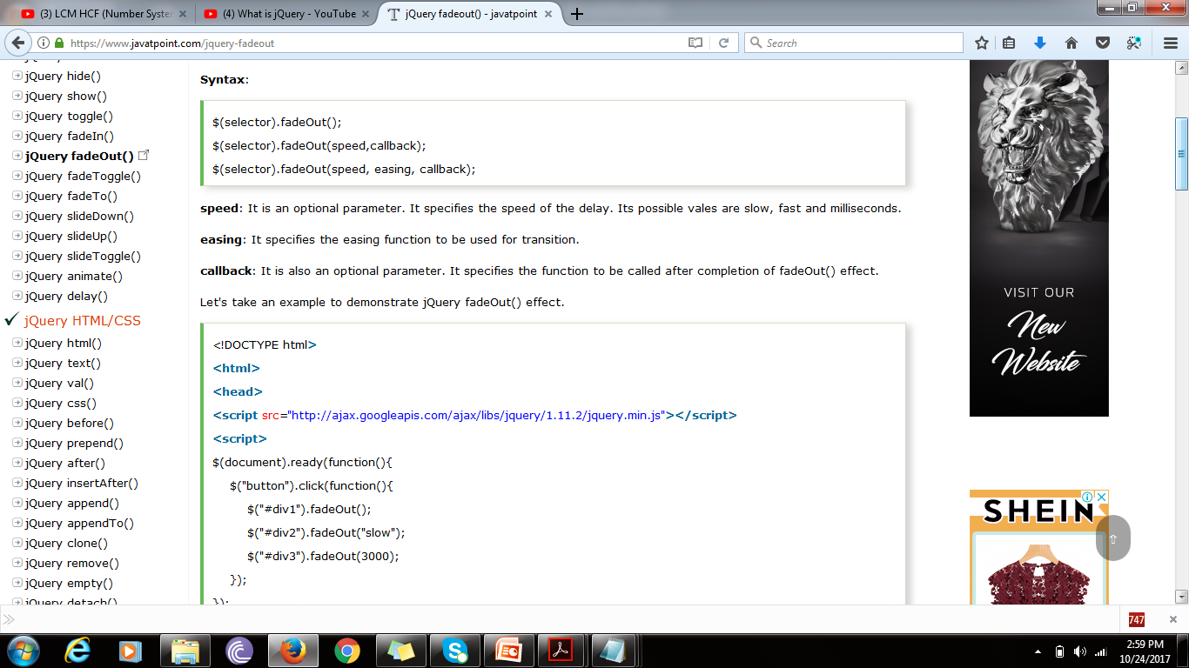
jQuery fadeOut()

Slide 27
<!DOCTYPE html>
<html>
<head>
<script src="https://ajax.googleapis.com/ajax/libs/jquery/3.2.1/jquery.min.js"></script>
<script>
$(document).ready(function(){
$("button").click(function(){
$("#div1").fadeOut();
$("#div2").fadeOut("slow");
$("#div3").fadeOut(3000);
});
}); </script></head><body>
<p>Demonstrate fadeOut() with different parameters.</p>
<button>Click to fade out boxes</button><br><br>
<div id="div1" style="width:80px;height:80px;background-color:red;"></div><br>
<div id="div2" style="width:80px;height:80px;background-color:green;"></div><br>
<div id="div3" style="width:80px;height:80px;background-color:blue;"></div>
</body>
</html>

Slide 28
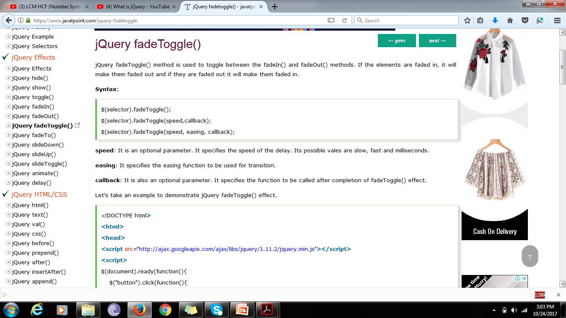
jQuery fadeToggle()

Slide 29
<!DOCTYPE html>
<html>
<head>
<script src="https://ajax.googleapis.com/ajax/libs/jquery/1.11.2/jquery.min.js"></script>
<script>
$(document).ready(function(){
$("button").click(function(){
$("#div1").fadeToggle();
$("#div2").fadeToggle("slow");
$("#div3").fadeToggle(3000);
});
});
</script>
Result

Slide 30
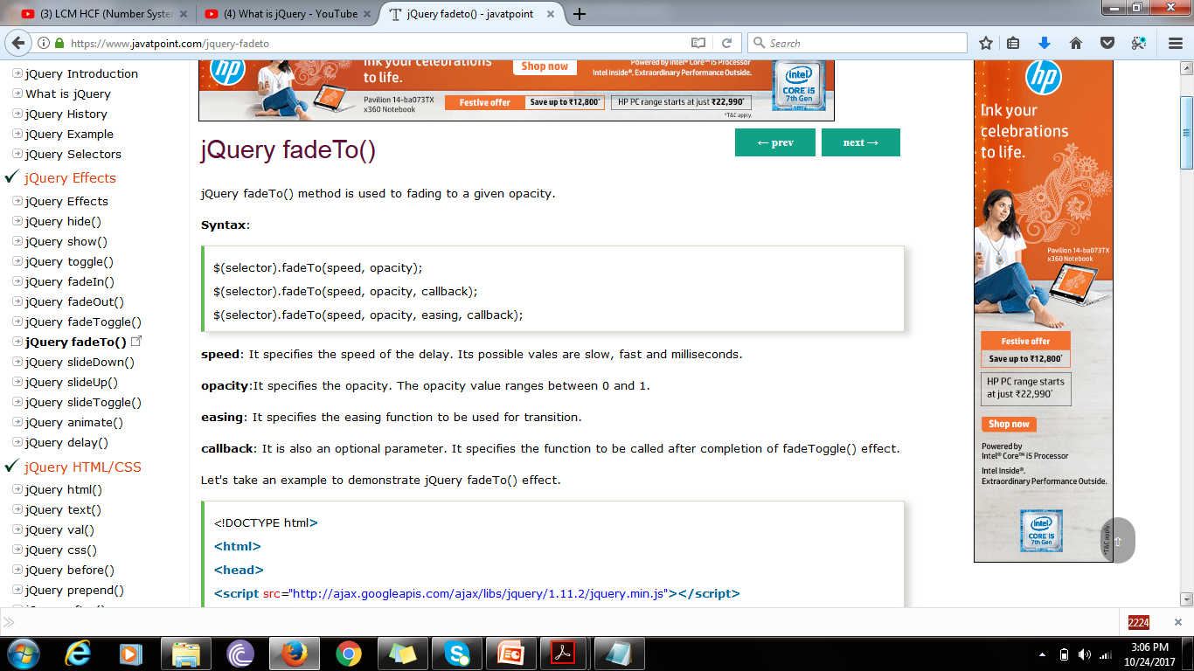
jQuery fadeTo()

Slide 31
<!DOCTYPE html>
<html>
<head>
<script src="https://ajax.googleapis.com/ajax/libs/jquery/1.11.2/jquery.min.js"></script>
<script>
$(document).ready(function(){
$("button").click(function(){
$("#div1").fadeTo("slow", 0.3);
$("#div2").fadeTo("slow", 0.4);
$("#div3").fadeTo("slow", 0.5);
});
});
</script>
result

Slide 32
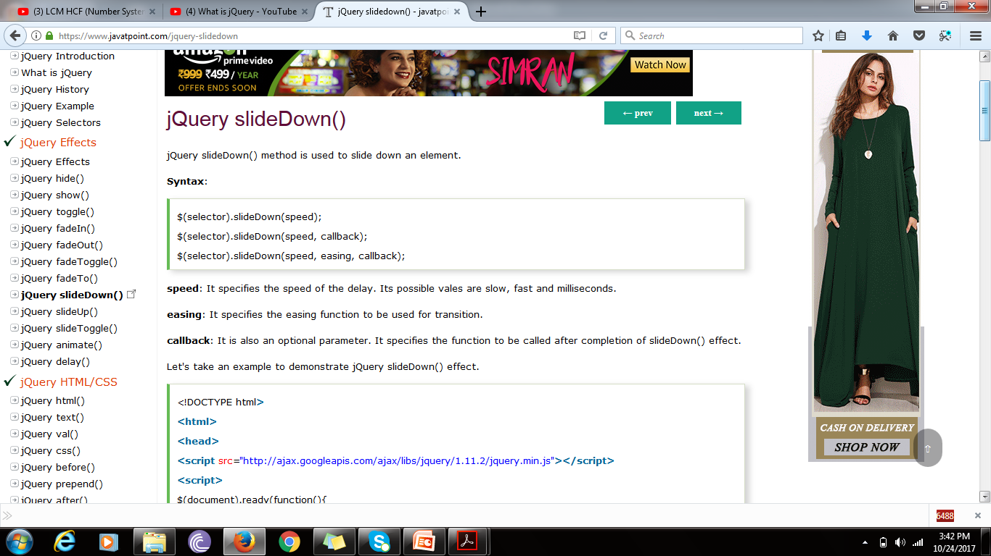
jQuery slideDown()

Slide 33
<!DOCTYPE html>
<html> <head>
<script src="https://ajax.googleapis.com/ajax/libs/jquery/1.11.2/jquery.min.js"></script>
<script>
$(document).ready(function(){
$("#flip").click(function(){
$("#panel").slideDown("slow"); }); }); </script>
<style>
#panel, #flip {
padding: 5px;
text-align: center;
background-color: #00FFFF;
border: solid 1px #c3c3c3;
}
#panel { padding: 50px;
display: none; }
</style> </head>
<body>
<div id="flip">Click to slide down panel</div>
<div id="panel">Hello
It is the best tutorial to learn jQuery and other languages.</div>
</body> </html>
Result

Slide 34
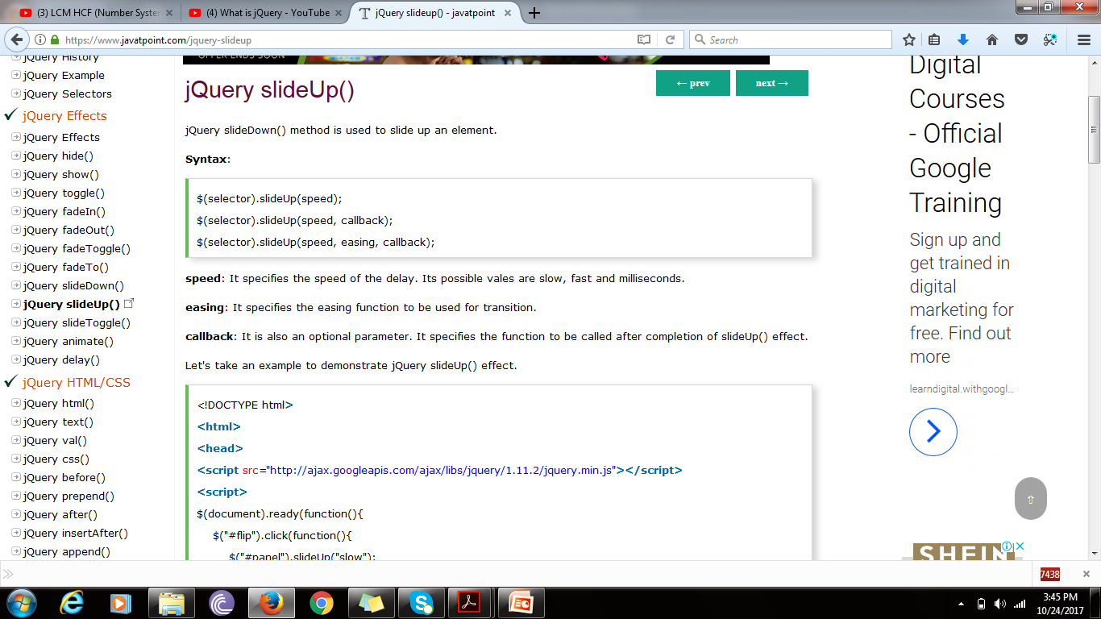
jQuery slideUp()

Slide 35
<!DOCTYPE html>
<html> <head>
<script src="https://ajax.googleapis.com/ajax/libs/jquery/1.11.2/jquery.min.js"></script>
<script>
$(document).ready(function(){
$("#flip").click(function(){
$("#panel").slideUp("slow"); }); }); </script>
<style>
#panel, #flip {
padding: 5px;
text-align: center;
background-color: #00FFFF;
border: solid 1px #c3c3c3; }
#panel { padding: 50px; }
</style> </head>
<body>
<div id="flip">Click to slide up panel</div>
<div id="panel">Hello javatpoint.com!
It is the best tutorial website to learn jQuery and other languages.</div>
</body>
</html>
Result

Slide 36
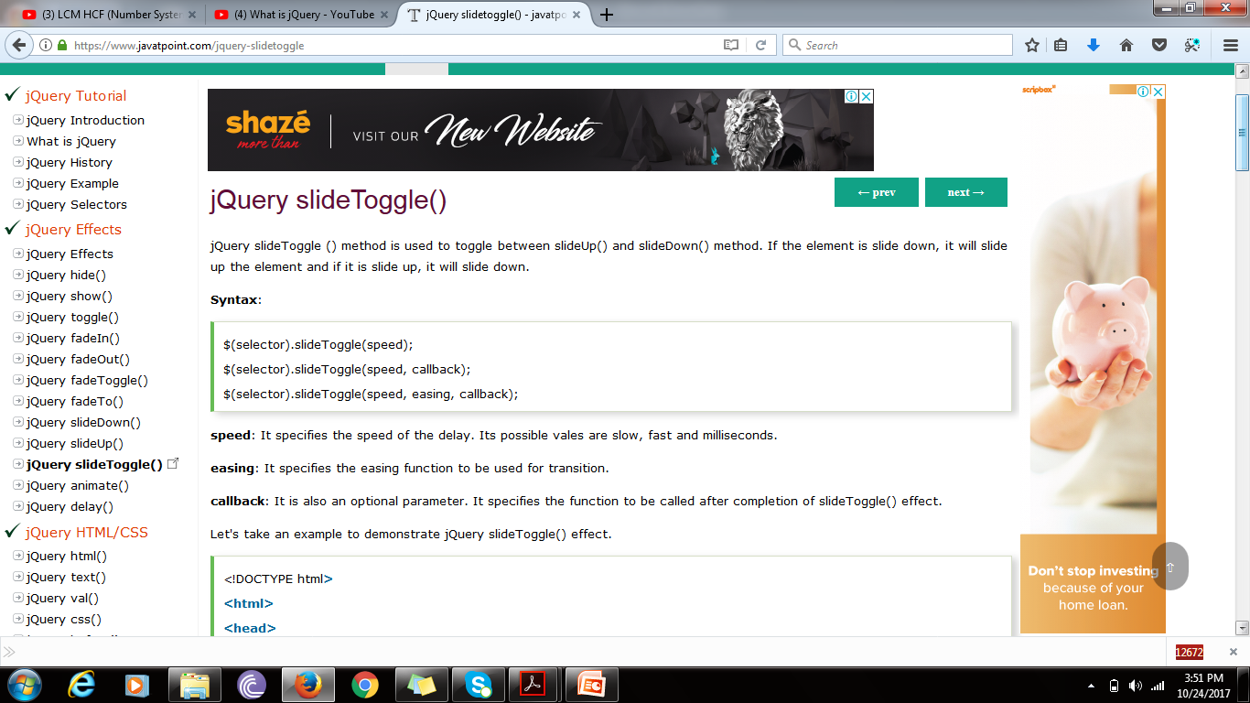
jQuery slideToggle()

Slide 37
<!DOCTYPE html>
<html> <head>
<script src="https://ajax.googleapis.com/ajax/libs/jquery/1.11.2/jquery.min.js"></script>
<script>
$(document).ready(function(){
$("#flip").click(function(){
$("#panel").slideToggle("slow"); }); }); </script>
<style>
#panel, #flip {
padding: 5px;
text-align: center;
background-color: #00FFFF;
border: solid 1px #c3c3c3;
}
#panel {
padding: 50px;
display:none;
} </style>
</head> <body>
<div id="flip">Click to slide toggle panel</div>
<div id="panel">Hello javatpoint.com!
It is the best tutorial website to learn jQuery and other languages.</div>
</body> </html>
Result

Slide 38
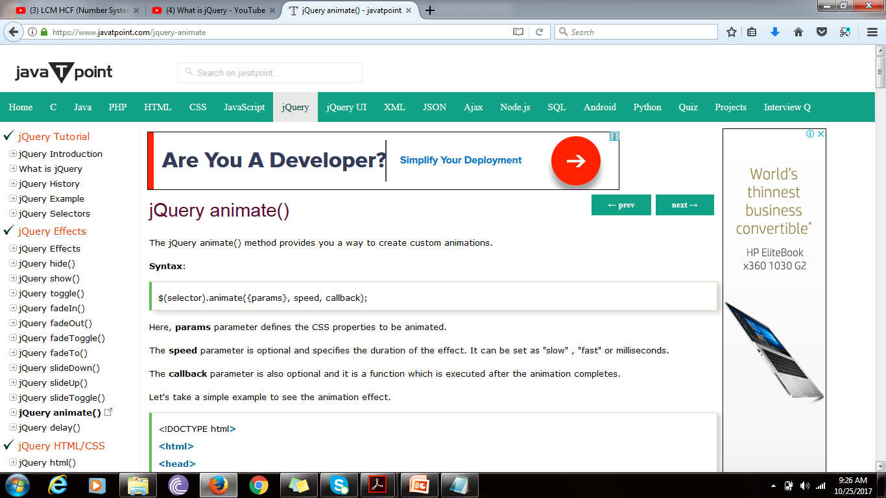
jQuery animate()

Slide 39
<!DOCTYPE html>
<html>
<head>
<script src="https://ajax.googleapis.com/ajax/libs/jquery/3.2.1/jquery.min.js"></script>
<script>
$(document).ready(function(){
$("button").click(function(){
$("div").animate({left: '250px'});
});
});
</script>
</head><body>
<button>Start Animation</button>
<p>By default, all HTML elements have a static position, and cannot be moved. To manipulate the position, remember to first set the CSS position property of the element to relative, fixed, or absolute!</p>
<div style="background:#98bf21;height:100px;width:100px;position:relative;"></div>
</body></html>

Slide 40
jQuery animate() method using multiple properties
<!DOCTYPE html>
<html><head>
<script src="https://ajax.googleapis.com/ajax/libs/jquery/3.2.1/jquery.min.js"></script><script>
$(document).ready(function(){
$("button").click(function(){
$("div").animate({
left: '250px',
opacity: '0.5',
height: '150px',
width: '150px'
}); }); });
</script> </head><body>
<button>Start Animation</button>
<p>By default, all HTML elements have a static position, and cannot be moved. To manipulate the position, remember to first set the CSS position property of the element to relative, fixed, or absolute!</p>
<div style="background:#98bf21;height:100px;width:100px;position:absolute;"></div>
</body></html>

Slide 41
jQuery animate() method using relative values
You can also define relative values (it is relative to the element's current value) by putting += or -= in front of the value.
<!DOCTYPE html>
<html><head><script src="https://ajax.googleapis.com/ajax/libs/jquery/3.2.1/jquery.min.js"></script>
<script>
$(document).ready(function(){
$("button").click(function(){
$("div").animate({
left: '250px',
height: '+=150px',
width: '+=150px'
});
});
});
</script>
</head>
<body>
<button>Start Animation</button>
<p>By default, all HTML elements have a static position, and cannot be moved. To manipulate the position, remember to first set the CSS position property of the element to relative, fixed, or absolute!</p>
<div style="background:#98bf21;height:100px;width:100px;position:absolute;"></div>
</body>
</html>

Slide 42
jQuery stop()
The jQuery stop() method is used to stop an animation or effect before it is finished.
The stop() method works for all jQuery effect functions, including sliding, fading and custom animations.

Slide 43
<!DOCTYPE html>
<html><head><script src="https://ajax.googleapis.com/ajax/libs/jquery/3.2.1/jquery.min.js"></script>
<script>
$(document).ready(function(){
$("#flip").click(function(){
$("#panel").slideDown(5000);
});
$("#stop").click(function(){
$("#panel").stop();
});
});</script><style>
#panel, #flip {
padding: 5px; font-size: 18px; text-align: center; background-color: #555;
color: white; border: solid 1px #666; border-radius: 3px;}
#panel {
padding: 50px; display: none;
}</style></head><body><button id="stop">Stop sliding</button>
<div id="flip">Click to slide down panel</div>
<div id="panel">Hello world!</div></body></html>

Slide 44
jQuery Callback Functions
$(selector).hide(speed,callback);

Slide 45
<!DOCTYPE html>
<html><head>
<script src="https://ajax.googleapis.com/ajax/libs/jquery/3.2.1/jquery.min.js"></script>
<script>$(document).ready(function(){
$("button").click(function(){
$("p").hide("slow", function(){
alert("The paragraph is now hidden");
});
});
}); </script></head><body>
<button>Hide</button>
<p>This is a paragraph with little content.</p>
</body></html>

